Slide 1
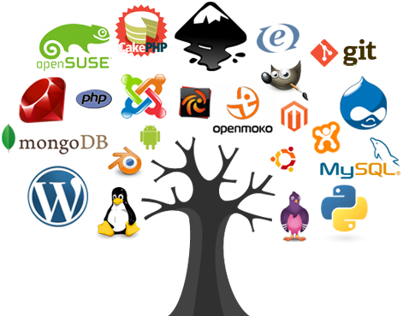
Open-Source Introduction
Definition, Examples and Tutorial
SoftUni Team
Technical Trainers
Software University
http://softuni.bg

Slide 2
Table of Content
Definition
Licenses & Standards
Development Models
Cathedral and Bazaar
Big Open-Source Projects
Learning from & Contributing to Open-Source

Slide 3
Have a Question?
sli.do
#tech-fund

Slide 4

Definition
What is Open-Source ?

Slide 5

Definition
Something that people can modify and share because it's design is publicly accessible
Open source software is software with source code that anyone can inspect, modify, and enhance
Open source technology and open source thinking both benefit programmers and non-programmers

Slide 6

What are Open Source Licenses ?
Open source licenses are licenses that comply with the Open Source Definition
They allow software to be briefly used, modified and shared
To be approved by OSI, a license must go through the OSI's license review process

Slide 7
Popular Licenses
The following OSI-approved licenses are popular, widely used, or have strong communities:
Apache License 2.0
GNU General Public License (GPL)
MIT license
Mozilla Public License 2.0
Common Development and Distribution License
Eclipse Public License
Comparison between licenses

Slide 8
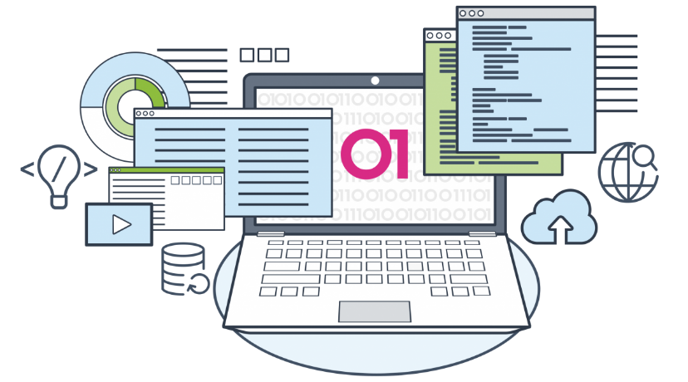
Development Models
Cathedral and Bazaar Models

Slide 9
The Cathedral: The "classic" model
Closed environment
Small group of leaders/developers
Used both in classic development models, such as waterfall, spiral and in classic OSS projects
Examples: GCC, GNU Emacs

Slide 10
The Bazaar – Introduced by Linus Torvalds
Open environment, almost any person can participate
Dynamic decision making structure
There are no clear leaders, undefined number of developers
However there is a benevolent-dictator figure
"Release early, Release often"
Example: Linux

Slide 11

Big Open-Source Projects

Slide 12

VS Code
Programming-focused text editor first released by Microsoft
Ranked the most popular developer environment tool in the Stack Overflow 2018 Developer Survey
with 34.9% of respondents claiming to use it

Slide 13

Node.js
Node.js is a JavaScript runtime built on Chrome's V8 JavaScript engine
It can execute JS code outside of a browser
Node is designed to build scalable network applications

Slide 14

Vue.js
One of the most prominent JavaScript frameworks on the market
Ranked up over 90,000 stars in GitHub
Vue.js has been learning from the past mistakes and successes of React and Angular

Slide 15
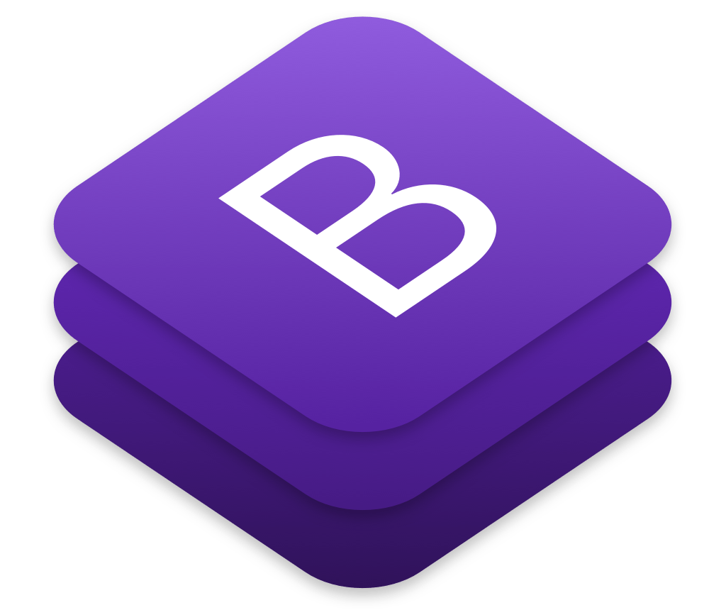
Bootstrap
Bootstrap is a frontend component library to help you build responsive, mobile-first projects using HTML, CSS and JavaScript
It was launched by Twitter in 2011

Slide 16

Contributing to Open-Source

Slide 17
Why contribute ?
A lot of people believe code should be open
Gives you a great start
Finding Bugs, Sending pull requests
Writing Clean Code
Be a part of a larger community
Try it out at: issuehub.io

Slide 18

Live Exercises

Slide 19

Summary
…
…
…
Open source software is software with source code that anyone can inspect, modify, and enhance
There are two Development Models
Cathedral
Bazaar
Contributing to Open-Source can be useful

Slide 20
https://softuni.bg/courses/technology-fundamentals

Slide 21













SoftUni Diamond Partners

Slide 22

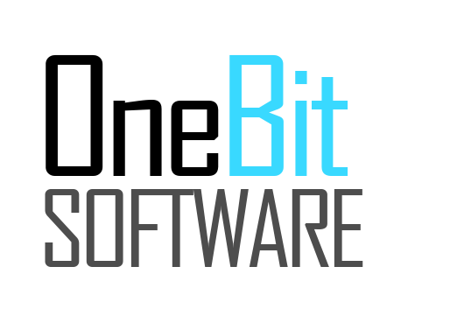
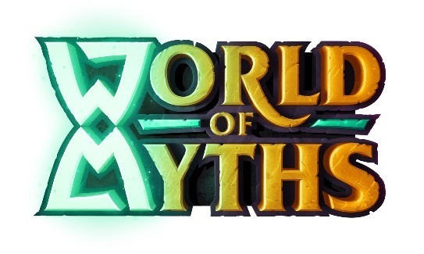


SoftUni Organizational Partners

Slide 23




Trainings @ Software University (SoftUni)
Software University – High-Quality Education and Employment Opportunities
softuni.bg
Software University Foundation
http://softuni.foundation/
Software University @ Facebook
facebook.com/SoftwareUniversity
Software University Forums
forum.softuni.bg

Slide 24

License
This course (slides, examples, demos, videos, homework, etc.) is licensed under the "Creative Commons Attribution-NonCommercial-ShareAlike 4.0 International" license

